Slide 1
Claims Phase 7 Changes What’s New, What’s Changed? What’s still coming ?
27 September 2017

Slide 2
New Features
The Build It logo is now on the landing page.
The Search screen now has the ability for you to select a date range.
New Claim Statuses:
Authorised to e-mail claim to supplier – applies to ‘DC Vendor’ claims only
Captured by DC
Claim Tolerances – Can be set by DC by Claim type so that claims below a configured value will not be imported to the Claims system
This is configured by DC by Claim Type.
This does not apply to Admin Claims
Three new Claim types have been introduced:
Build IT DC
These used to be ‘Supplier’ dropshipment claims where the supplier was the Build IT DC
Build IT DC Admin Claims
This used to be Admin Claims where the supplier was the Build IT DC
DC Vendor Claims
This is new – allows the DC to raise claims on suppliers who deliver into the warehouse e.g. Unilever; These claims are not store related.

Slide 3
New Fields on the CMS Manage screen and the Claims Stats report
Uplift / DC Reference Number – this field that can be entered on a claim.
Authorised by Rep Indicator – this is a ‘Yes’/’No’ field that can be entered on a claim.
Outcome Reasons by DC – this is a standard list of reasons that the DC can assign to a claim e.g. Dc error, Store error.

Slide 4
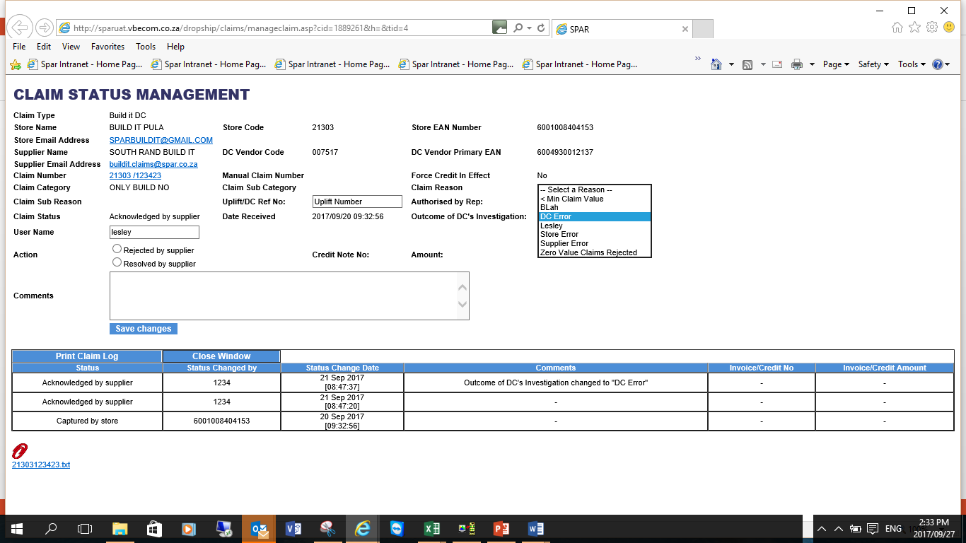
New Fields on CMS Manage screen

Slide 5
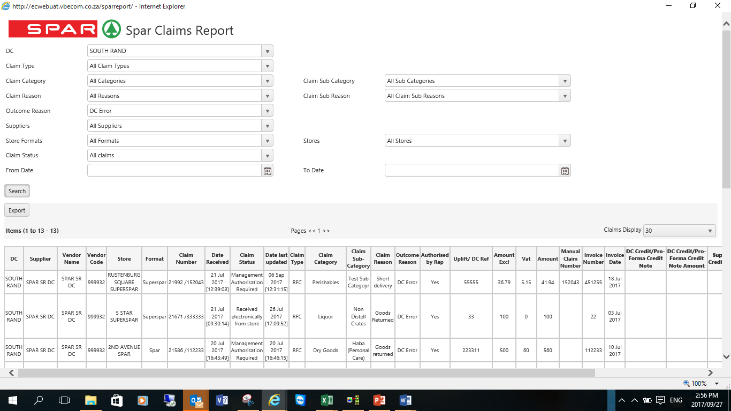
New Selection and Fields on Claims Stats report

Slide 6
Validations on CMS screen for Warehouse and the (new) DC Vendor Claims
On the CMS screen the claim category, claim sub category, claim reason and claim sub reason entered must conform to one of the workflow configurations for your DC.
Example:
If you do not a have a workflow config setup for category ‘Dry Goods’ and Claim Reason ‘Pricing’ then you cannot set the category and reason accordingly on the CMS screen.

Slide 7
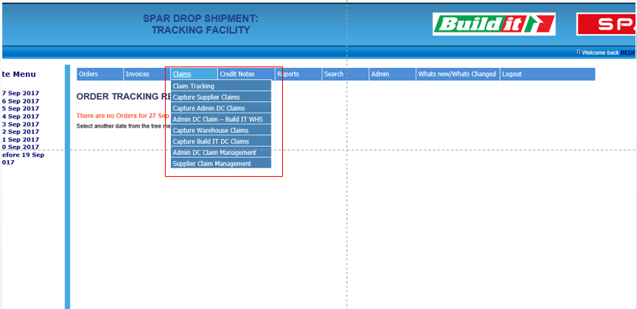
New Claim Capture Features
Users must select the type of claim to be captured from the Claims Menu as shown on screen shot below.
Menu options shown will depend on the store format i.e. only Build It stores will be able to capture Build IT DC and Build It DC Admin Claims.
DC’s will have the option to capture ‘DC Vendor’ Claims.
DC’s can decide if they want to allow zero value claims to be captured e.g. Build IT DC do not require the cost to be captured on ‘Pricing’ or ‘Subsidy’ claims.
This is configurable by DC and by claim type.

Slide 8
Build IT DC Admin Claims
These claims used to be ‘Admin DC Claims’ but the store used to have to select the Imports WHSE/Build IT DC as the Supplier.
They will no longer have to do this as the supplier will automatically be set to be the Build IT DC.
The type of claim is still ‘Admin DC Claim’.
These claims will be managed by the Build IT DC

Slide 9
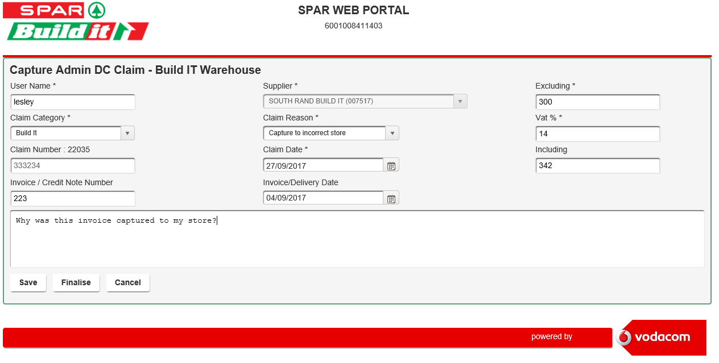
Build IT DC Admin Claims capture screen

Slide 10
Build IT DC Claims
These claims used to be ‘Supplier’ claims on the Build IT DC but have now been converted to be claim type ‘Build IT DC’
They will be managed by the Build IT DC
A Text file is created as soon as the Build IT DC ‘Acknowledges’ the Claim.
This text file can then be imported into the Build IT DC’s internal claims system to check the invoice numbers, product codes etc.
Other DC’s may intervene in the management of these claims but this option will only be switched on by request

Slide 11
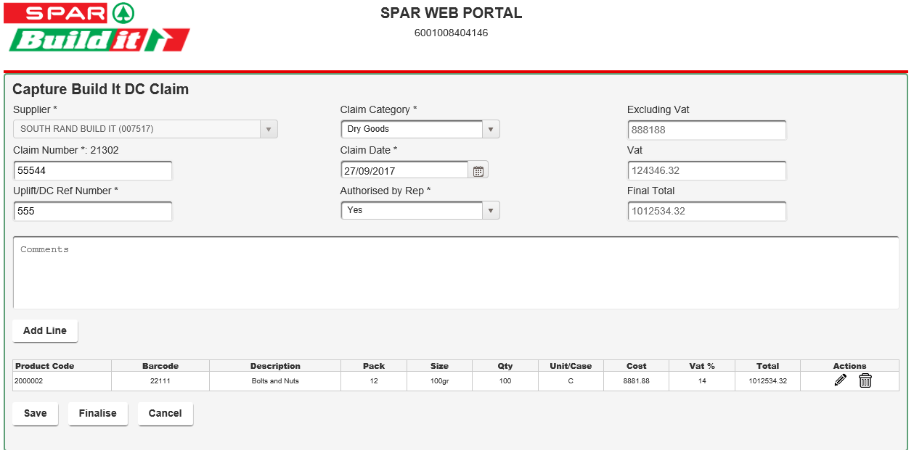
Build IT DC Claims Capture screen

Slide 12
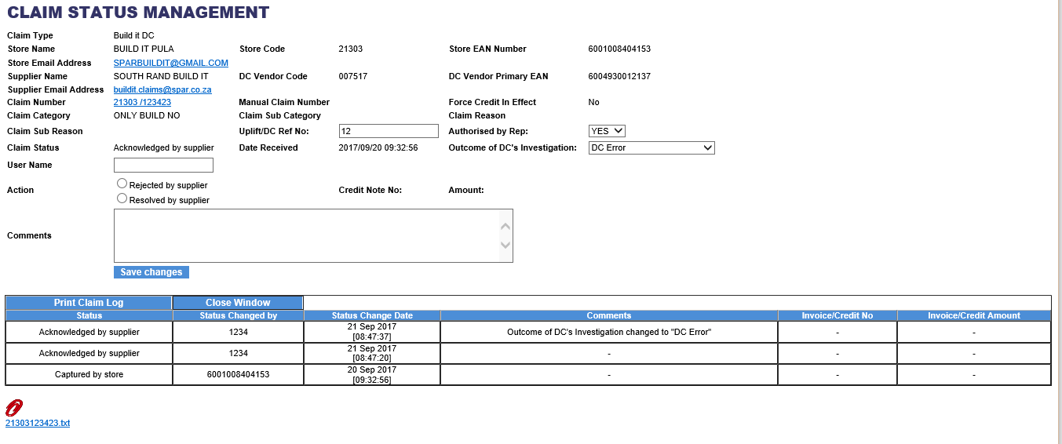
Build IT DC Manage screen
Text file that can be downloaded to Build IT’s claims system for validation; Click on hyperlink

Slide 13
DC Vendor Claims
These claims allow you to raise claims against warehouse vendors
Only DC users have access to this function
These vendors must be warehouse ordering EDI suppliers
The workflow is set up similarly to warehouse claims
If you want to use this you need to please tell me what claim categories etc. you require as we will need to configure them and the users who must receive the corresponding e-mail notifications
The final workflow step of these claims will be authorisation to e-mail the claim to the warehouse supplier
You will be required to enter the DC’s Purchase Order number and amount as well the supplier’s invoice number, date and amount

Slide 14
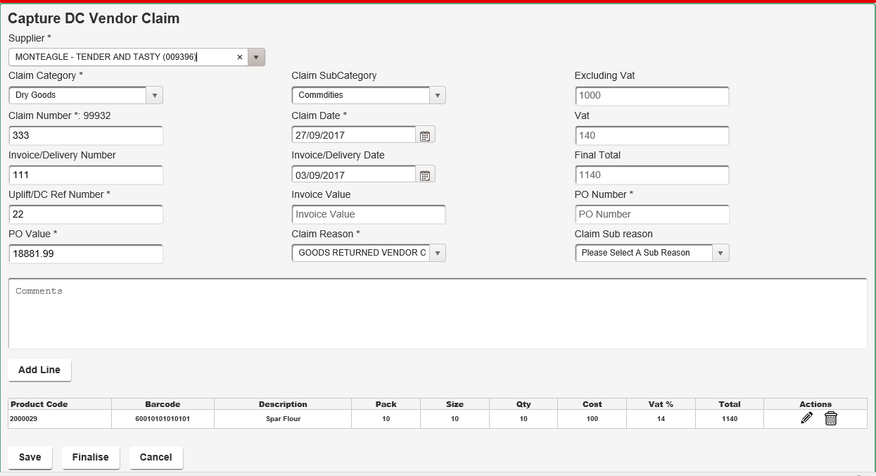
DC Vendor Claims Capture screen

Slide 15
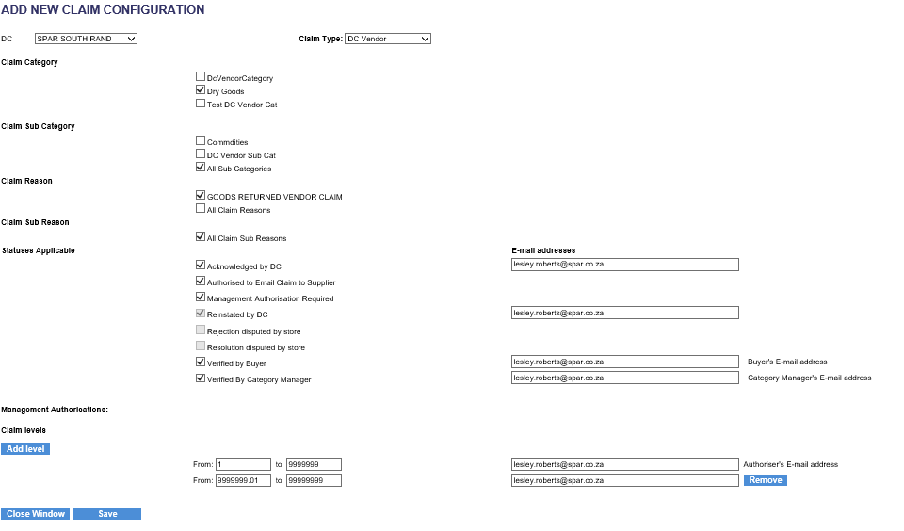
DC Vendor Claims Config

Slide 16
What is still to come?
The buyer name as an enterable field on the CMS screen
Ability to select claims on the CMS and the stats report for a selected buyer
Ability to show / capture the invoice number on the CMS screen
Ability to change the manual claim number on the CMS screen
Showing an attachment paperclip on the CMS and on the Stats report so that you can easily see if the store have scanned in the supporting docs for a claim.
Ability for stores to reject their own claims.
Allowing the DC to generate individual force credits from the CMS screen – will generate a credit note that will be received into RTS and the Debtors and Creditors systems

Slide 17
What is still to come?
Additional validations when schedules are uploaded:
Validate that the schedule does not contain a mixture of docs for Build It and non Build It stores
Validate the referring claim number on the schedules to ensure it matches to an existing claim on the CMS
Allow the Referring claim number to be rectified when it is found to be invalid on the schedules
New report – Weekly matched Claim report
Shows which claims were matched by which credits in the past / selected week
Closing the CMS window to take the user back to where they were rather than to the top of the grid.

Slide 18
Feedback to Lesley required
Claim Tolerances by DC by Claim type – applies to captured claims and claims received from SIgma
Allow zero value claims to be captured – by DC by claim type
Does not apply to Admin Claims
Switching on DC Vendor Claims and the configs required

